Slide 1
Library Management System
Group Members:
Hamza
Aymen
Sahiba

Slide 2
Library Management System
We can manage library by:
Adding new books to the library.
Updating book information such as
Title
Author
rating
publisher.
Deleting books from the library.
View detailed information about a book.

Slide 3
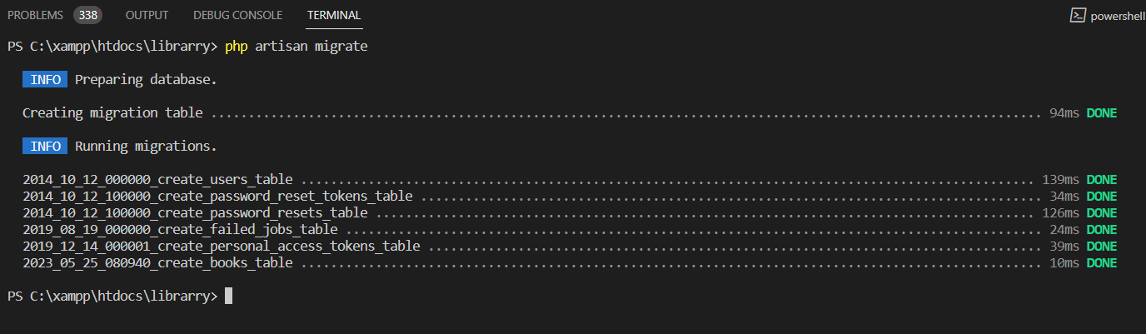
What is migration in Laravel ?
Migration in Laravel: Managing and versioning database schema changes.
Migrations are files stored in “database/migrations” directory.
Each migration file represents a specific database change (e.g., creating a table, adding columns).

Slide 4
Controller
&
Model
Handles HTTP requests and responses
Acts as a bridge between user requests and application logic
Organizes and separates application logic
Represents a data entity (e.g., a database table)
Interacts with the database and performs data operations
Defines relationships between entities

Slide 5

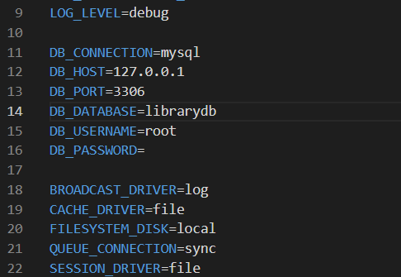
What is env file?
The .env file in Laravel is a configuration file that stores environment-specific settings for your application.
The .env file contains sensitive information such as database credentials, API keys, and other configuration values, and should not be committed to version control.

Slide 6
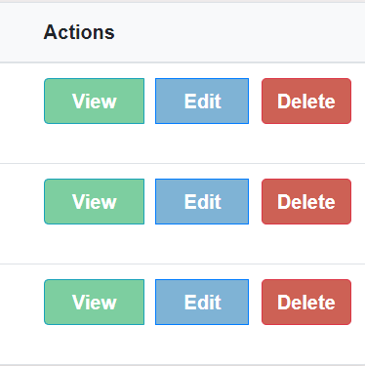
Resource Controller
Simplifies basic operations (create, read, update, delete) on a resource.
Follows rules for handling actions based on HTTP methods.
Follows rules for handling actions based on HTTP methods.

Slide 7
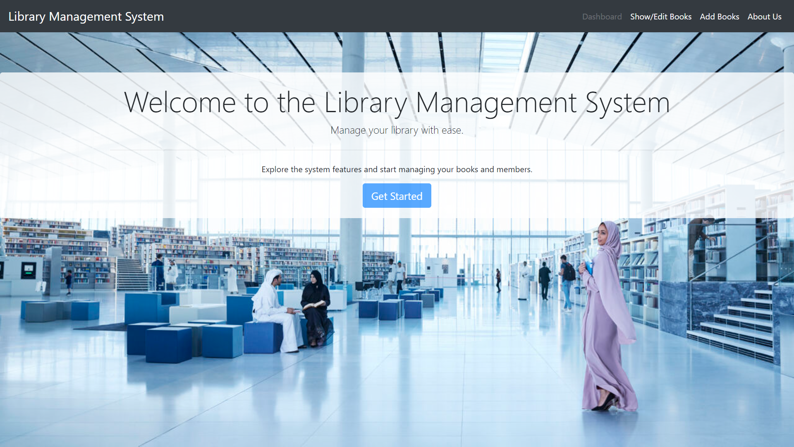

Slide 8
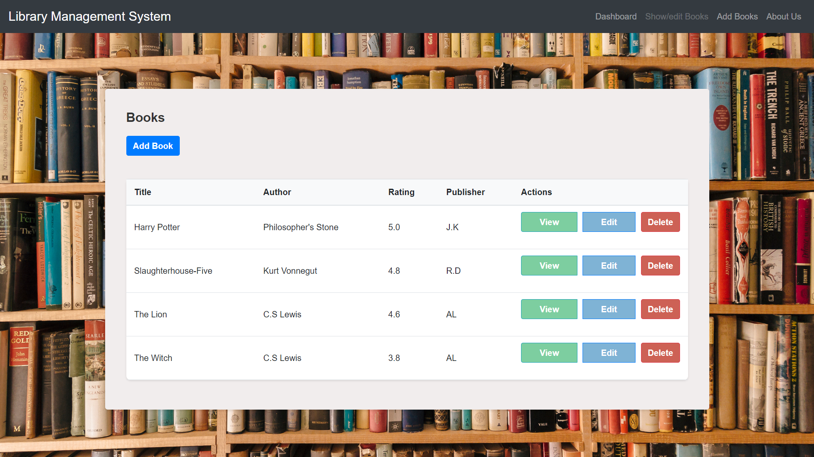

Slide 9
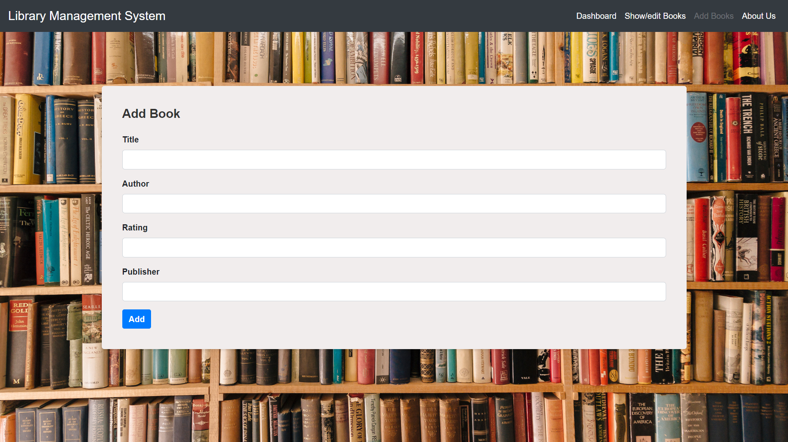

Slide 10
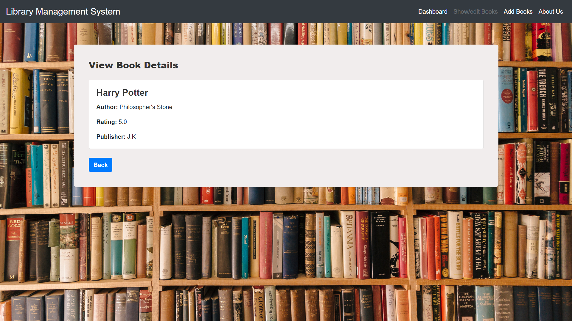

Slide 11
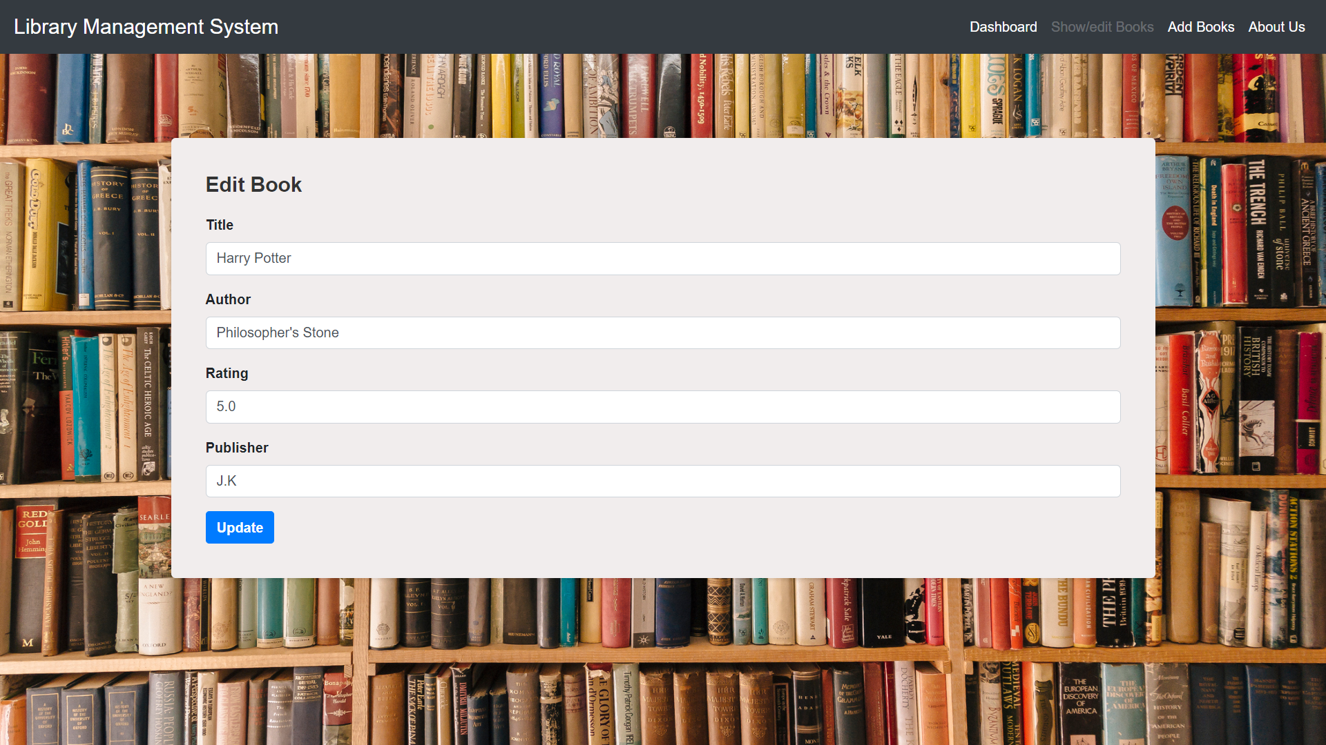

Slide 12
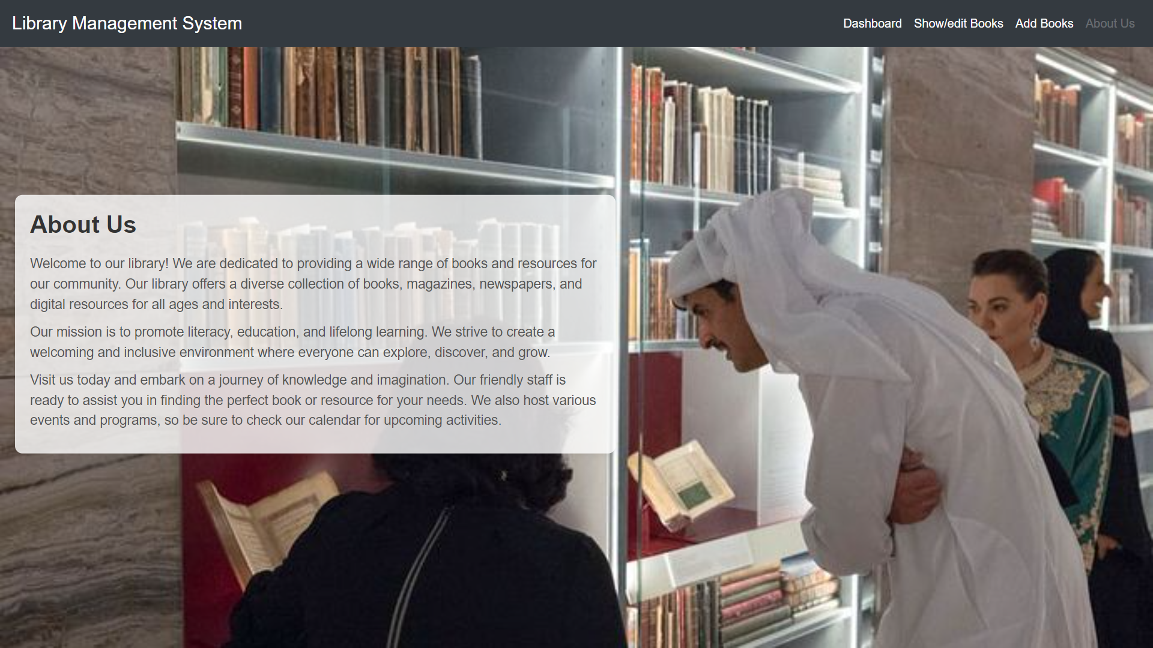
Any Questions?

